Slide 1
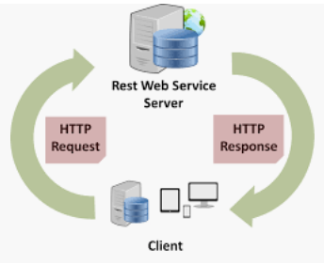



Documenting restful services with Swagger
-- #greenlearner --

Slide 2
Agenda
What is swagger
How to add swagger in spring boot project
How to use swagger to test our REST API

Slide 3
Recap..
Build REST full service
Spring-boot-devtools
Actuator

Slide 4
What is Swagger?
Swagger takes the manual work out of API documentation, with a range of solutions for generating, visualizing, and maintaining API docs.
Easily integrates with spring boot project.

Slide 5
Add swagger into spring boot
The Swagger 2 specification, which is known as OpenAPI specification,
This has several implementations, we’ll use the Springfox implementation
compile group: 'io.springfox', name: 'springfox-swagger2', version: '2.9.2’
implementation group: 'io.springfox', name: 'springfox-swagger-ui', version: '2.9.2'

Slide 6
Swagger to test our API
Demo

Slide 7
References
https://swagger.io/solutions/api-documentation/
https://swagger.io/tools/swagger-ui/
https://github.com/swagger-api

Slide 8
Next..
Properties..
Yaml

